Slide 1

GIFT CITY AIF · INBOUND
Motilal Oswal Alternative Investment
Centricity WealthTech · Partner Reckoner · August 2026

Slide 2
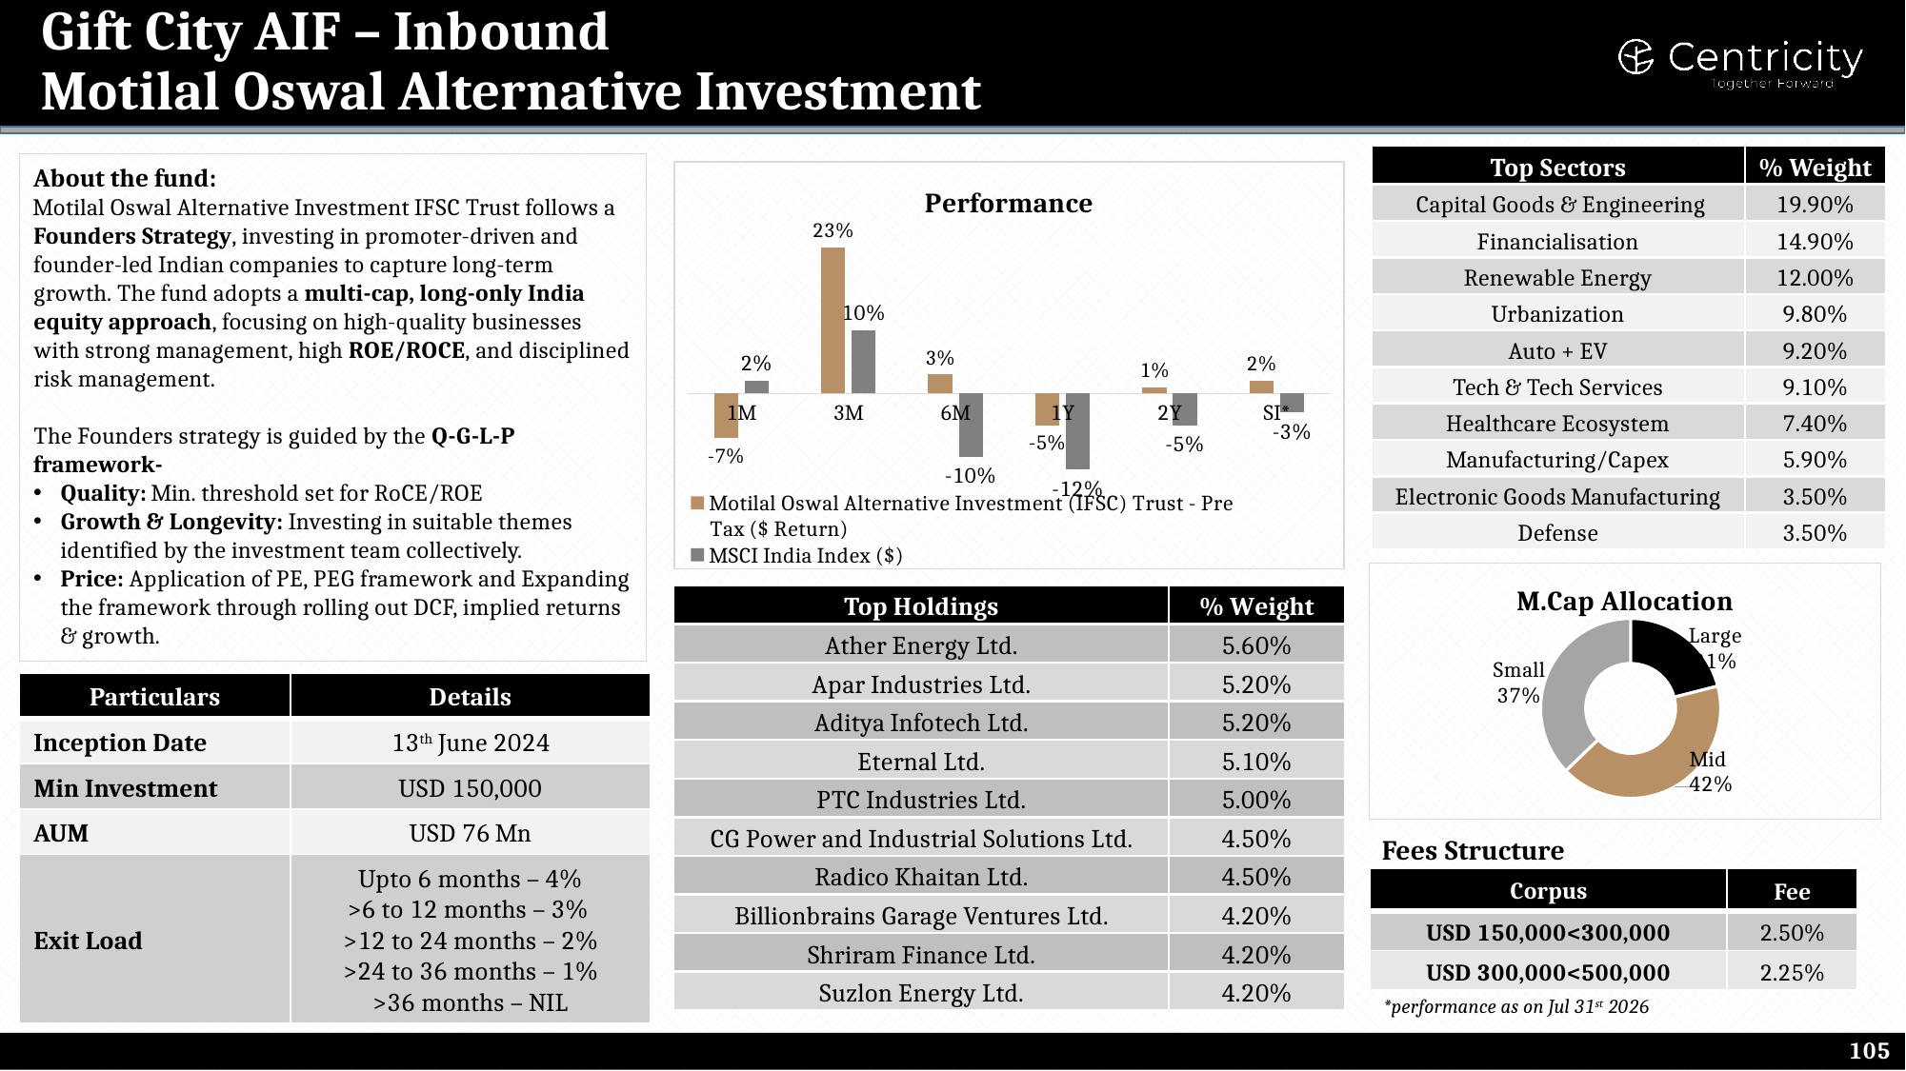

Slide 3

DISCLAIMER
Centricity Group operates through its respective registered entities: AMFI (ARN: 189274) – Centricity Financial Distribution Pvt. Ltd. | APMI (APRN: 00803) – Centricity Financial Distribution Pvt. Ltd. | PMS (Registration No.: INP000010007) – Centricity Portfolio Managers Private Ltd. | RIA (Registration No.: INA00018559) – Centricity Advisory Services Pvt. Ltd. | RA (Registration No.: INH000029102) – Centricity Securities Private Limited.
This material is for informational purposes only and does not constitute investment advice. Investments are subject to market risks; please read all scheme / offer documents carefully. Past performance is not indicative of future results.

Slide 4
Thank You
centricity.co.in · Together Forward

